Slide 1
IMM120 – Feb 19
Images / Text / Sprite Sheets
All Sketches from Class: https://alpha.editor.p5js.org/crhallberg/sketches
Reminder: https://pastebin.com/YByGz6Rh
Notes:
Presentations are up on Canvas: Files > Presentations
Next class: functions, effects, intro midterm. Don’t forget music next week.

Slide 2
Today in IMM120
Image Review
Making Memes
Galloping Llamas

Slide 3
Debug Puzzle
Did anyone try it?

Slide 4
Mirror Drawings
Great job!
Notes:
Simple, save to variables, translate and scale
Shifted instead of mirrored.

Slide 5
Translation and Rotation
push(); - save current transform state
translate(x, y); - Move origin by x and y (relative)
rotate(radians); - Rotate origin by radians (relative)
scale(x, y); - Change drawing scale (relative)
pop(); - return to previously saved state

Slide 6
screen // grid

Slide 7
translate(x, y)

Slide 8
rotate(radians)

Slide 9
scale(x, y)

Slide 10
push() and pop()

Slide 11
push() then translate(x, y)

Slide 12
then rotate(radians)

Slide 13
rect(100, 100, 100, 30);

Slide 14
translate(x, y)

Slide 15
pop();

Slide 16
Translation and Rotation
push(); - save current transform state
translate(x, y); - Move origin by x and y (relative)
rotate(radians); - Rotate origin by radians
scale(x, y); - Change drawing scale (relative)
pop(); - return to previously saved state

Slide 17
Images
Source image
Load image
Display image

Slide 18


Images
Source image (postimage.org)
Load image
Display image

Slide 19
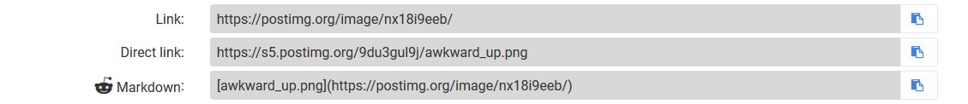
Images
Source image (postimage.org)
Load image
Display image

Slide 20
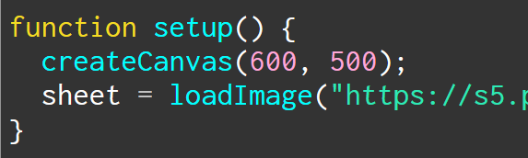
Images
Source image
Load image (make variable, loadImage)
Display image

Slide 21
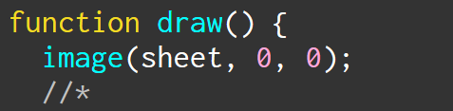
Images
Source image
Load image
Display image (use image command)
x y

Slide 22
Making Memes
Images, fancy text, input, boolean combination

Slide 23
https://postimg.org/gallery/2wrxm8h9w/
All the images for today’s class

Slide 24
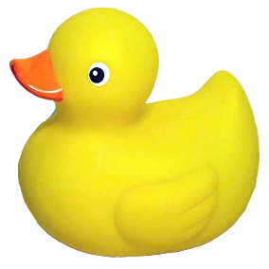
Making Memes
You’re turn to code!
Take the meme images from the gallery
https://postimg.org/gallery/2wrxm8h9w/
Display each meme
Make a mMODE for each meme
Switch from one to the next
I recommend function keyPressed() for this
Notes:
I split the penguin memes in half, don’t worry about it. There’s a good reason for it.

Slide 25
% - modulo
Returns the remainder of simple division
7 % 2 == 2
6 % 3 == 0
3 % 5 == 2

Slide 26
Counting with Modulo
3 % 0 == 0
3 % 1 == 1
3 % 2 == 2
3 % 3 == 0
3 % 4 == 1
3 % 5 == 2
3 % 6 == 0

Slide 27
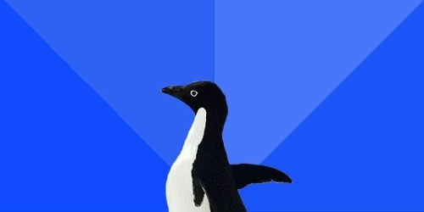
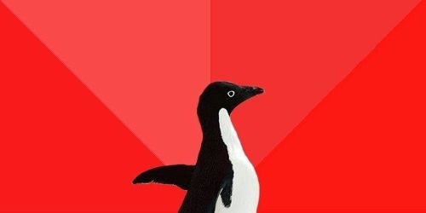
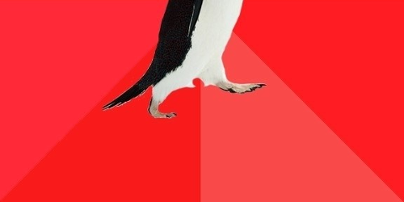
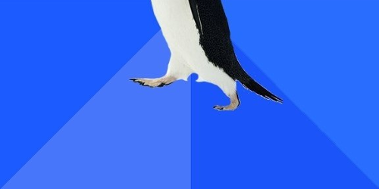
What About These?
Notes:
You may have noticed I split the penguin memes in half…
Make a mode for these real quick

Slide 28
Combining Boolean Ideas
We want to display the upper awesome penguin when:
AWESOME PENGUIN or AWKWARD->AWESOME PENGUIN
Strict boolean logic
AND for when both have to be true (You and I will be there)
OR for when either is true (You or I will be there)

Slide 29


Combining Boolean Ideas
AND → &&
OR → ||
Notes:
pipe

Slide 30
Combining Boolean Ideas
if (mode == mAWESOME || mode == mAWK_AWESOME) {

Slide 31
Combining Boolean Ideas
if (mode == mAWESOME || mode == mAWK_AWESOME) {
IF THIS IS TRUE OR THIS IS TRUE,
execute the contained code

Slide 32
Adding Text
topText = prompt(“TOP TEXT?”);
topText.toUpperCase();

Slide 33
Spritesheets
Animated images
Notes:
GIFs don’t work easily
Sprites are the way to go

Slide 34
https://www.piskelapp.com
A free, online spritesheet drawing

Slide 35
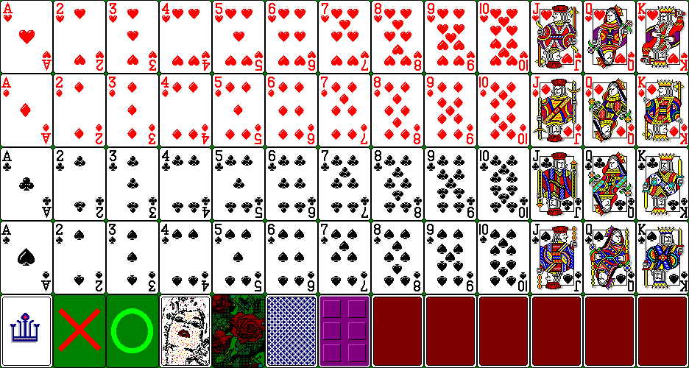

Slide 36
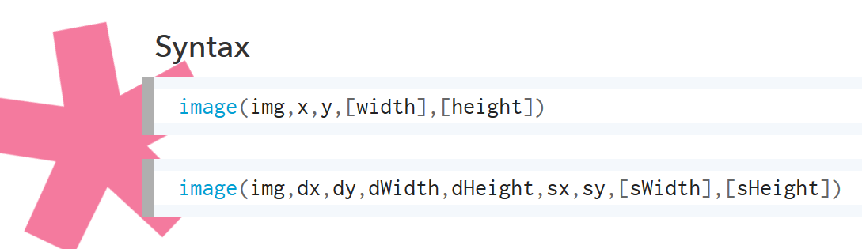

Slide 37
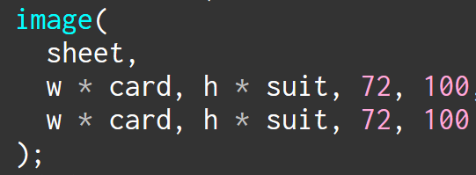

Slide 38
72 times the card you want
0 72 144 216 288 360 432
Notes:
Notice that we start at 0 here

Slide 39
0
100
200
300
100 times the suit you want
Notes:
Notice that we start at 0 here

Slide 40
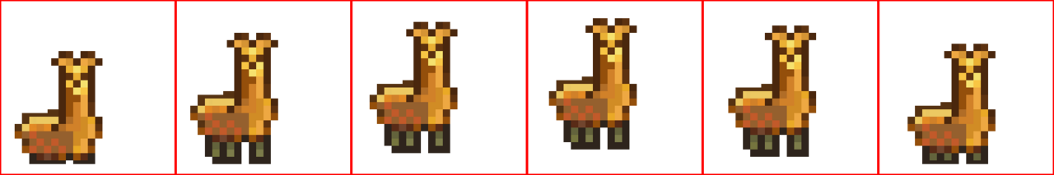

Slide 41
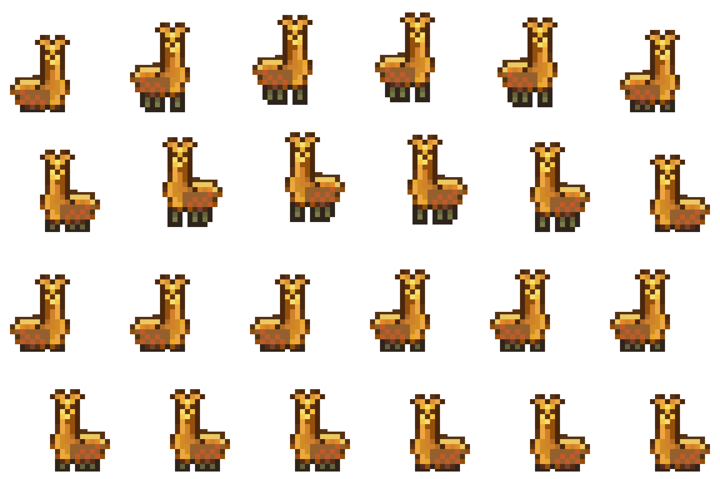

Slide 42
Bouncing right
Bouncing left
Standing right
Standing left

Slide 43
Think of Midterm Ideas
Something you’re passionate about.
Something you never got to try.
Something in the news that inspired you.
Notes:
Intro next week: Feb 26, play with ideas, March 5 is a lab, due the Friday before break.

